Slide 1
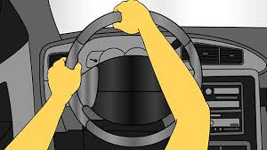
SE50 – Torque Steer Compensation
Description
Use EPS to compensate for steering torque created by vehicle
Initial version to comprehend low-frequency response
Must include a “learning feature”
Motivation (Score 3.5)
Requested by GM on K2xx, required for C1xx
Deliverables
Modeled FDD including test plan and calibration strategy
Successful implementation on C1xx
Timing
Oct 2014
Team Members/Customers
Price Lefler, Shrenik Shah / C1xx

Slide 2
SE50 – Torque Steer Compensation
Status
Performance of base function without learning demonstrated internally and to GM – Performance meets expectations
Acceptable learning performance demonstrated internally
Challenges
Robustness to operating conditions
Next Steps
Demonstrate learning feature to GM
Create FDD

